Slide 1

Introduction to Cryptography Curtis Badke February 26th, 2019

Slide 2
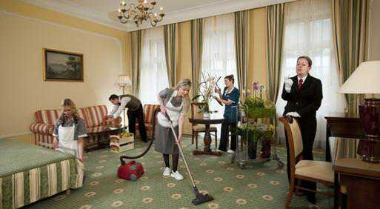
Housekeeping
Mar 26th - Lighting talks!
Looking for a Membership Director.
Dev Edmonton Slack channel.
Hiring or looking for work?
Notes:
Introduce yourself and other EDMUG executives.
Lighting talk presenters?
Anyone want to be help us out as Membership Director?
Discuss .NET on the Dev Edmonton Slack channel.
Anyone hiring or looking for work?

Slide 3

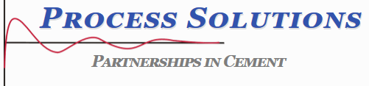

Thanks to Our Sponsors
Are you interested in being a sponsor? Let use know.
Notes:
Process Solutions, JetBrains. Any other sponsors?

Slide 4

Introduction to Cryptography
Curtis Badke
Curtis has been working as a .NET consultant for DevFacto Technologies for the past 7 years and over the two years and a half has been building products on the Azure stack. When not frantically trying to keep up with the deluge of new offerings from Azure, Curtis dabbles in security research and swinging golf clubs. As always I encourage the members of the group to send me any specific questions they have so that I can try to address them. Folks are welcome to email me at hello@curtisbadke.ca or contact me on the DevEdmonton Slack (@cbad).
Notes:
Past EDMUG presentations:
- Secrets Management (Oct 2017)
Works at DevFacto.

Slide 5
Wrap-up
Survey and prize draw! Constructive feedback appreciated.
Next meetup: Mar 26, Lighting Talks!
Contact: info@edmug.net http://edmug.net
Notes:
Thank the presenter, sponsors, and members.

